Slide 1



Git Essentials [ for monsoon ]
Haggai Philip Zagury, Yael shoval, Monsoon Cloud
Sep, 2013

Slide 2

Where are we ?
EC2API
Foundations
Git intro
Chef intro
Automation
Continuous Delivery
Advanced Chef
Background
Monsoon UI
Monsoon UI
Devenv (BuildEnv)
Could intro
To be
continued …

Slide 3

Basic understanding of git
How to use git with Monsoon

Slide 4



Why do we (monsoon) need git ?
A way to communicate with monsoon
An interface in which one can control and instance without connecting to it
A way to version our instance / entire infrastructure(s)

Slide 5
What are VCS anyway ?
A means to a goal which is tracking changes / versions of files
Time

Slide 6

What is git
Git is a free and open source distributed version control system designed to handle everything from small to very large projects with speed and efficiency.
Git is easy to learn and has a tiny footprint with lightning fast performance. It outclasses SCM tools like Subversion, CVS, Perforce, and ClearCase with features like cheap local branching, convenient staging areas, and multiple workflows.
source: git-scm.org

Slide 7









There are two types of VCS’s
Distributed
Centralized
All repos are create equal
One “master” to rule them all
Notes:
In a centralized model users must be online in order to collaborate and almost every command / operation requires you you be online.
In Distributed model everything is local … commit, branch, merge tag etc etc

Slide 8
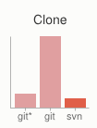
Dvcs vs. Cvcs
Cons
Distributed - pros
Extremely fast because the tool only needs to access the local hard drive
Commits are local without anyone else seeing them. when you are ready to share => share
You can work offline ! [ no internet / vpn etc ]
Share between developers before sharing with everyone
DVCS Can do everything a Centralized repository, and much more ...
large binary sync might take a lot of disk space
Initial sync will take longer for all history to download

Slide 9
Git basic commands
git init
git clone
git config
git add
git commit
git status
git log
git push
git pull
Notes:
How to interact with files and managing files lifecycle through a repository with Git command.
We will see in the following slides exactly how to create, config, add etc etc ..

Slide 10
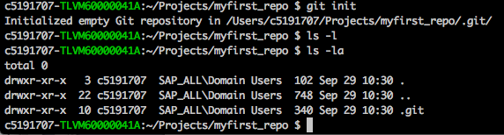
Git init
Initialize a repo
Initialize a git repository in a local directory
git init
Notes:
Create / Initialize a repository
You can also user –bare – this creates the repository in a “server” mode – a mode you would usually clone / pull from basically its equivalent to the .git in a non-bare repository

Slide 11
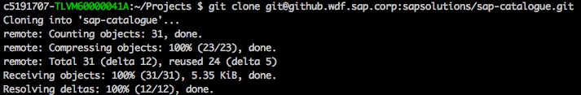
Git clone
Clone existing
Clone the content of a remote repository
git clone <url[git,http/s,file]> [ <directory> ]
git clone git@github.wdf.sap.corp:sapsolutions/sap-catalogue.git
Notes:
A complete replica the entire history of the repository is pulled down from the server to your local machine !
You can use git (ssh), http or https an even the file url
Git clone file:///path/to/repo

Slide 12

Git config
Configure git – this info will be used when you add files to the repository
git config --global user.name "My username”
git config --global user.mail my_email@sap.com
git config –global core.editor vim => sets vim as the default editor …
And many more options …
Notes:
Every commit to the repository must have a commit and an owner ! Who committed it
Git config user.name / user.email are a must !
--global sets it once for all repositories on that machine stored in ~/.gitconfig
Without the –global flag it will be stored in your repository/.git/config

Slide 13
Git add
Adding files to the index / staging area
git add tells git you are going to commit this file to the repository and adds it to a staging / index area.
Usually after git add you will git commit
In order to add all untracked files use:
git add .
Notes:
Files in a directory are just files until they are git added
Once they are git added they are in status “to be committed”

Slide 14
Git commit
Move files from the index / staging area into the repository
git commit [ -m “Some meaningful message” ]
Notes:
After adding to index take from the index into the repository

Slide 15

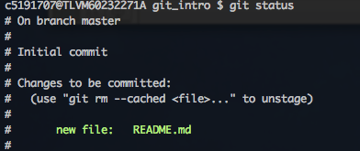
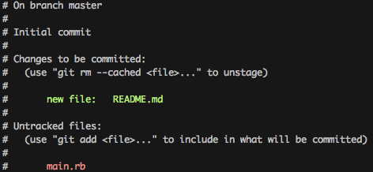
Git status
So once we added a file to the index, we can see it is “to be committed” status

Slide 16
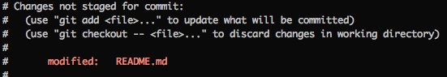
Git status
Once we edit a file it becomes “modified” and should be added to the index …

Slide 17

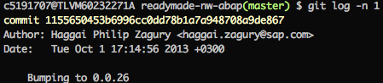
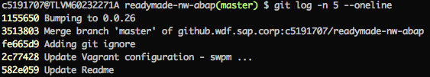
Git log
git log
git log [ –oneline, -n <limit> ]

Slide 18
Git push
Upload repository content to a centralized location
Your local branch [ a.k.a mainline ] is called master
The Remote master is called origin so:
git push –u origin master
Will Store your repository remotely
remote

Slide 19

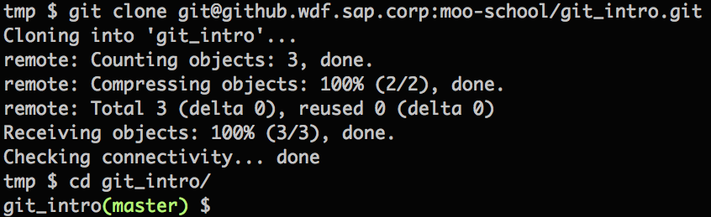
Git By Example
Clone a repository:
git clone git@github.wdf.sap.corp:moo-school/git_intro.git
Master
branch

Slide 20
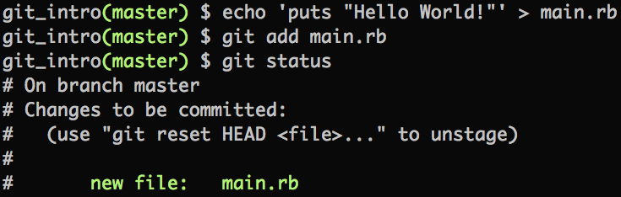
Git By Example
Create & add a file to index:

Slide 21
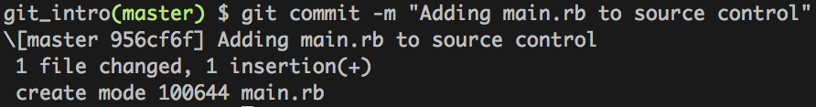
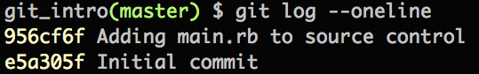
Git By Example
Commit the file to the repository
Check history ?!

Slide 22
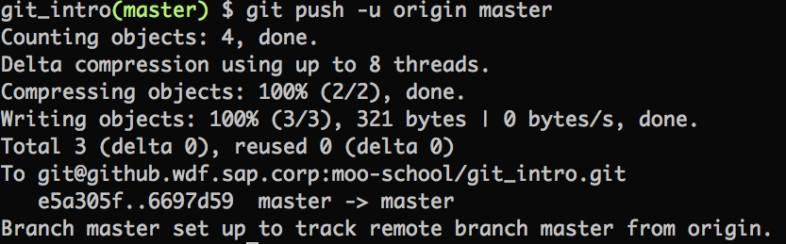
Git By Example
Sharing your changes with the world !
Master
local
Master
remote

Slide 23
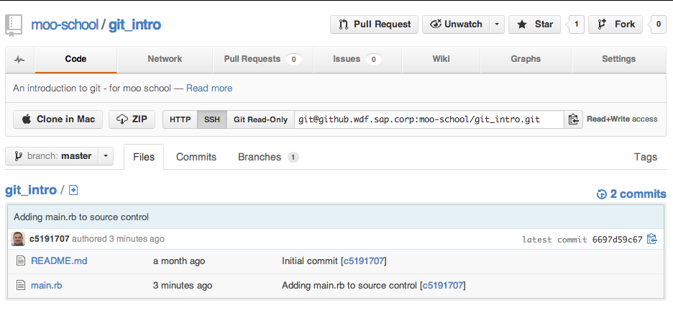
Git By Example
If your server has a graphical interface … you can see:

Slide 24

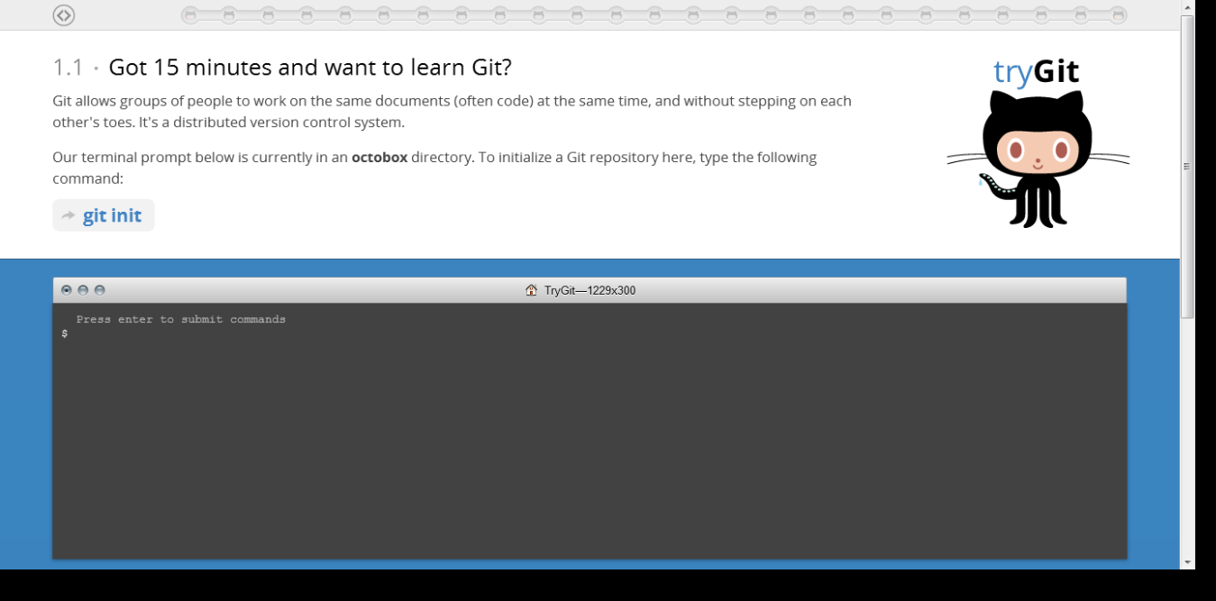
Exercise
Notes:
http://try.github.io/levels/1/challenges/1

Slide 25
Exercise
Git & SSH Setup

Slide 26
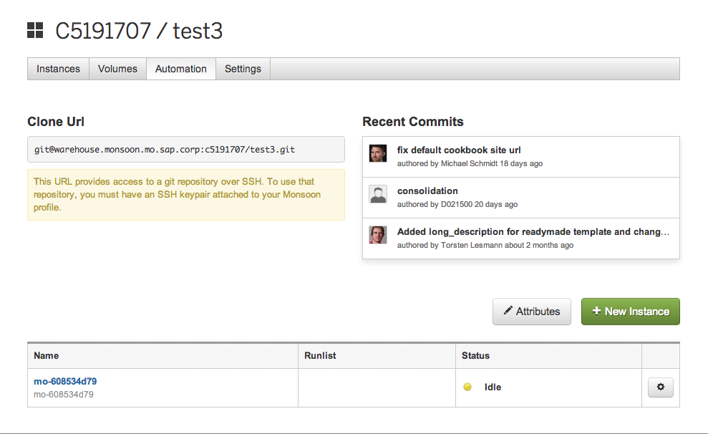
Git in Monsoon 2.0 – Automation interface
remote
Git log

Slide 27
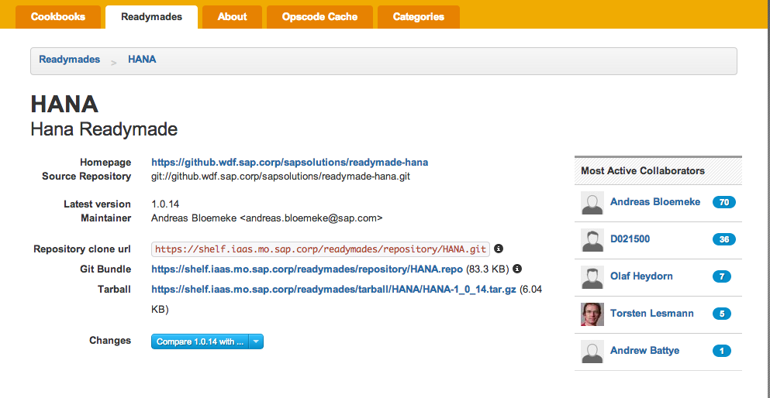
Git in Monsoon 2.0 - shelf
We store “readymades” / cookbooks in git
Git log
remote
Git log

Slide 28
Don’t hesitate to contact us
Join our community: IT Solution Engineering
Email our team:
DL IT Cloud COE InfraSwat (External)
DL IT WebKM Monsoon Development (External)
DL IT MONSOON CONSULTING (External)
DL IT_MONSOON_SUPPORT (External)
Haggai Philip Zagury, Yael Shoval, Monsoon Cloud
Sep, 2013

